Slide 2
Rust 在 CeresDB 中的一种并发模型实践
锐航

Slide 3
About me
锐航
蚂蚁集团开发工程师
GitHub: waynexia

Slide 4
Contents
About CeresDB
Rust 在 CeresDB 中的一种并发模型实践
Join us

Slide 5






01
About
CeresDB

Slide 6
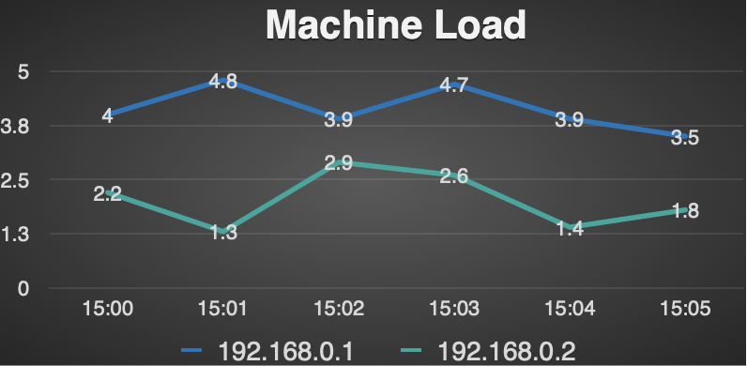
Timeseries Data Characteristics
Write
smooth and continuous
high throughput
less update and no delete
Query
trend over time
aggregation calculation on massive data
Scene
APM
IOT
Financial System
Timestamp | Tag（host） | Tag（cluster） | Value（load）
2022-06-26 15:00 | 192.168.0.1 | A | 4.0
2022-06-26 15:01 | 192.168.0.1 | A | 4.8
2022-06-26 15:02 | 192.168.0.1 | A | 3.9
2022-06-26 15:03 | 192.168.0.1 | A | 4.7
2022-06-26 15:04 | 192.168.0.1 | A | 3.9
2022-06-26 15:05 | 192.168.0.1 | A | 3.5
2022-06-26 15:00 | 192.168.0.2 | B | 2.2
2022-06-26 15:01 | 192.168.0.2 | B | 1.3
2022-06-26 15:02 | 192.168.0.2 | B | 2.9
2022-06-26 15:03 | 192.168.0.2 | B | 2.6
2022-06-26 15:04 | 192.168.0.2 | B | 1.4
2022-06-26 15:05 | 192.168.0.2 | B | 1.8

Slide 7
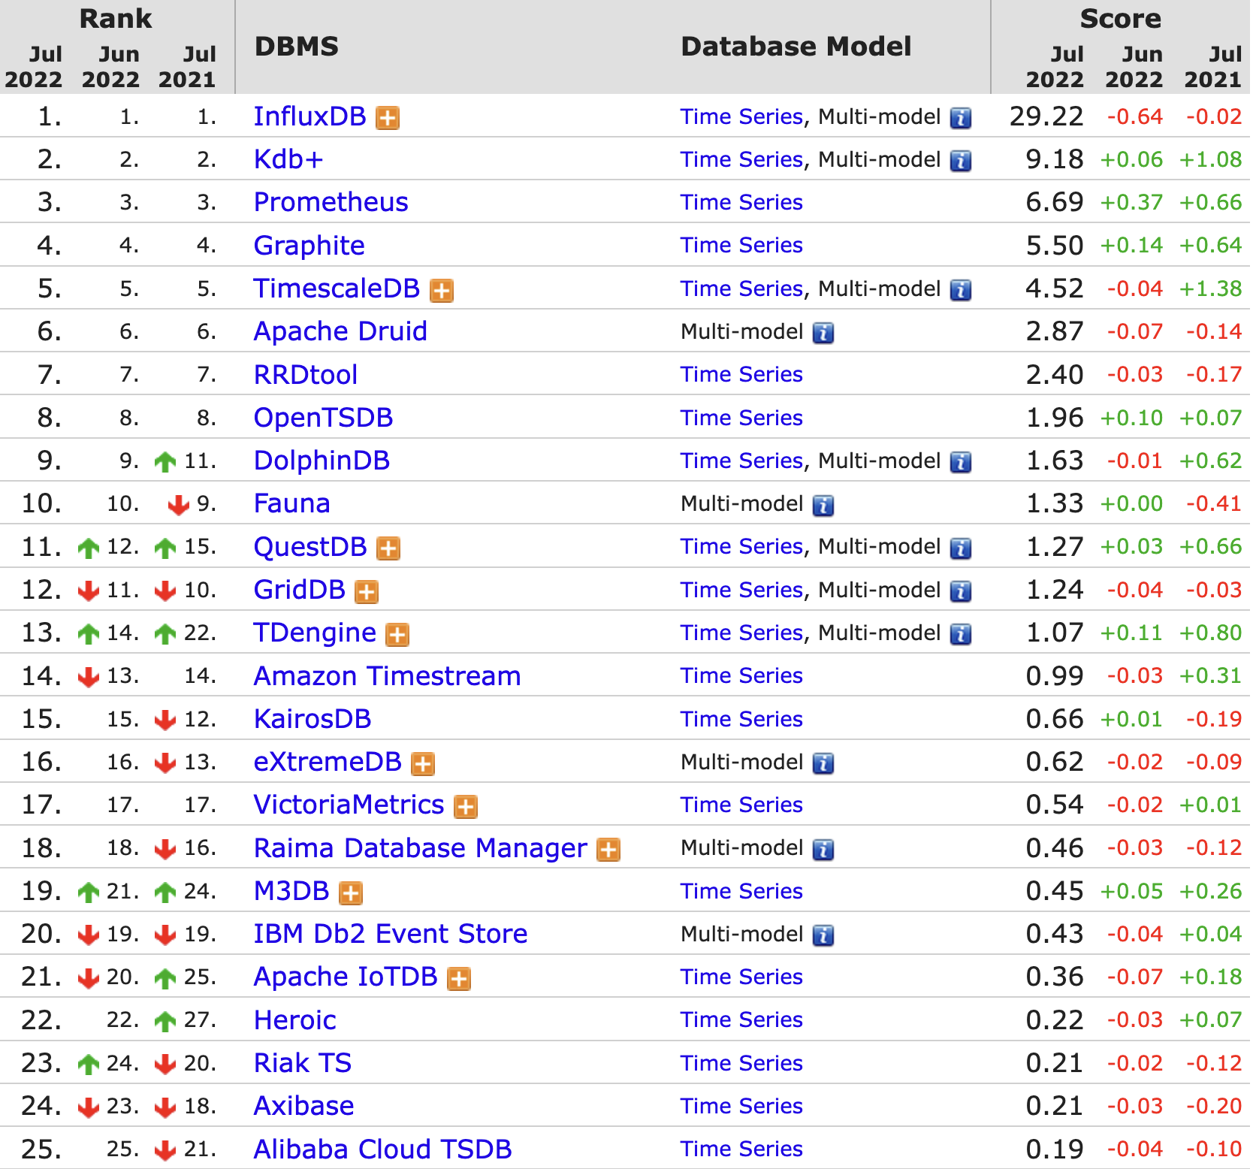
Timeseries Database
Rank (Popularity)
Dilemma
Performance: high cardinality of timeseries lead to very slow query
Scalability: most TSDBs are standalone

Slide 8
Why CeresDB
Traditional TSDB
inverted index to handle all the workloads
More advantages
Distributed TSDB
high availability and reliable
high scalability
Intelligent TSDB
Auto determine suitable params by analyzing data
Auto schedule workloads across the cluster
UDF based on embedded python runtime
CeresDB
two kinds of workload: timeseries and analytical
hybrid storage format and query mode to handle workloads

Slide 9

Roadmap
Milestone 1
Milestone 2
Afterward
Time: 2022.7
Features:
Distributed version supports static topology
The underlying storage supports Aliyun OSS
WAL implementation based on OBKV
Time: 2022.10
Features:
Support Prometheus remote read
Hybrid Storage storage format
Distributed WAL implementation
Support horizontal scaling
Features:
Python UDF
Adaptive scheduling
Adaptive index
Performance improvement

Slide 10
02
Rust 在 CeresDB 中的一种并发模型实践

Slide 11
Why you use this
Simplify state management
Reduce resource competition
Reduce context switch
Improve CPU affinity

Slide 12
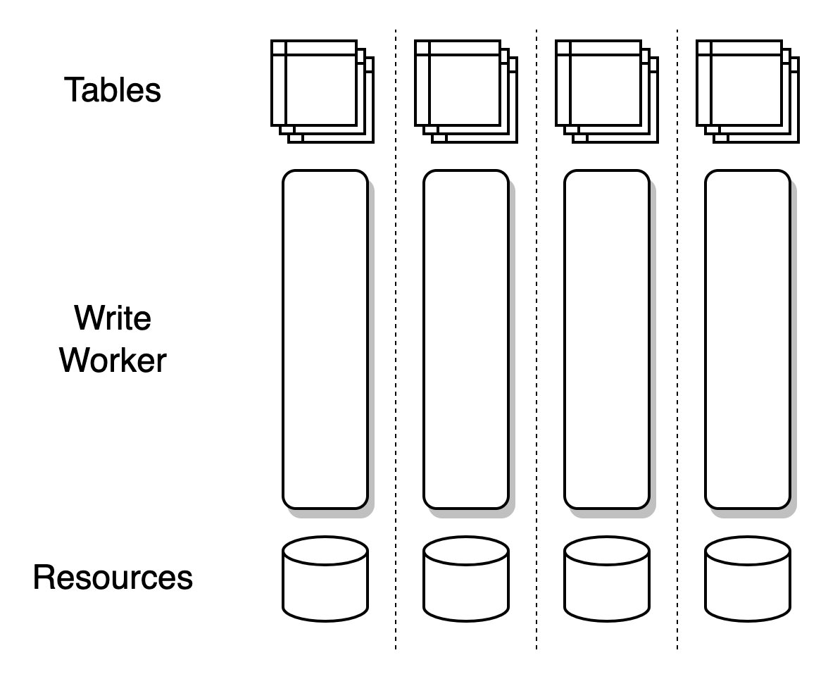
Write Worker in CeresDB
Each table is assigned to one worker
Each worker owns one thread
Workers are independent
Resources are occupied by workers
Easy to avoid write-write conflict
No resource competition

Slide 13
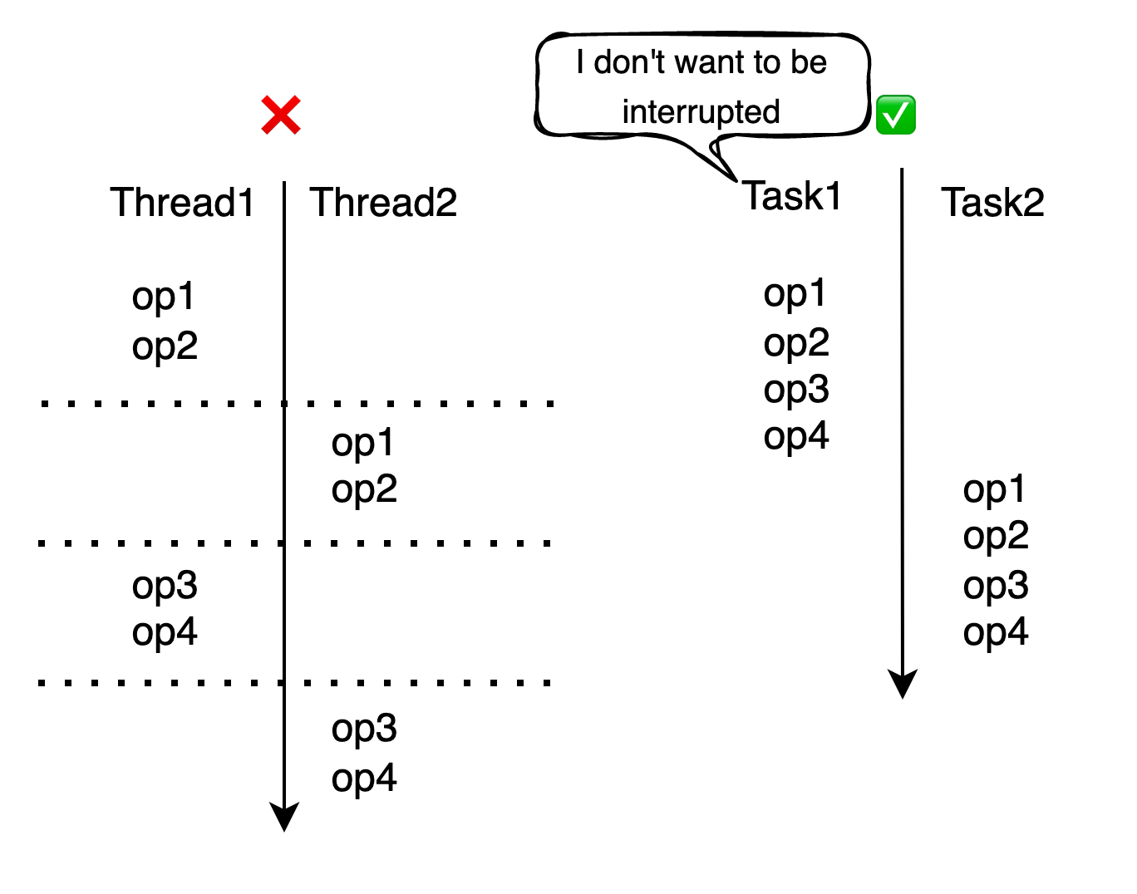
What does it look like?
Cooperative schedule.

Slide 14

What does it look like?
Atomic as much bits as you want (back to the ancient !)
Arc ⇒ Rc
AtomicT ⇒ T
Hair losing lock free ⇒ Hair

Slide 15
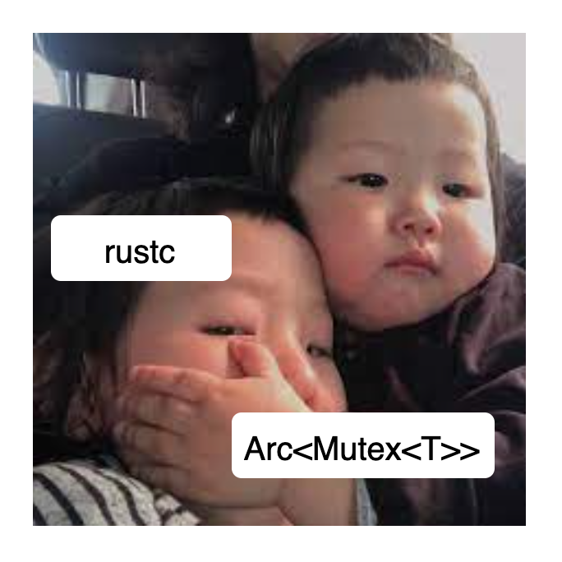
What does it look like?
Coding inside a world does not require Send
A type is Send if it is safe to send it to another thread.
pub fn spawn<T>(future: T) -> JoinHandle<T::Output>
where
T: Future + Send + 'static,
T::Output: Send + 'static,
Notes:
What is `Send` and `!Send`
Send is required almost every places

Slide 16
What does it look like?
Cheap interior mutability
Mutate variables without extra check

Slide 17
What does it look like?
But lock is still needed to sync state between tasks
Not the traditional lock
All task should be non-blocking

Slide 18
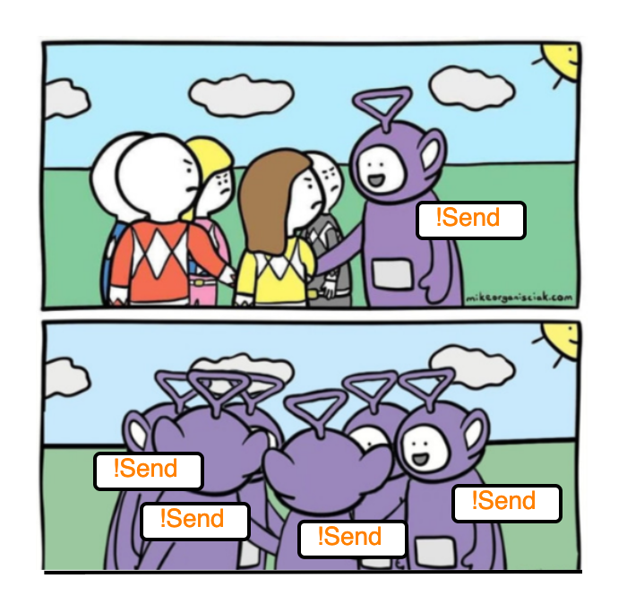
And what, must we give in return
Force sharding
Coinductive

Slide 19
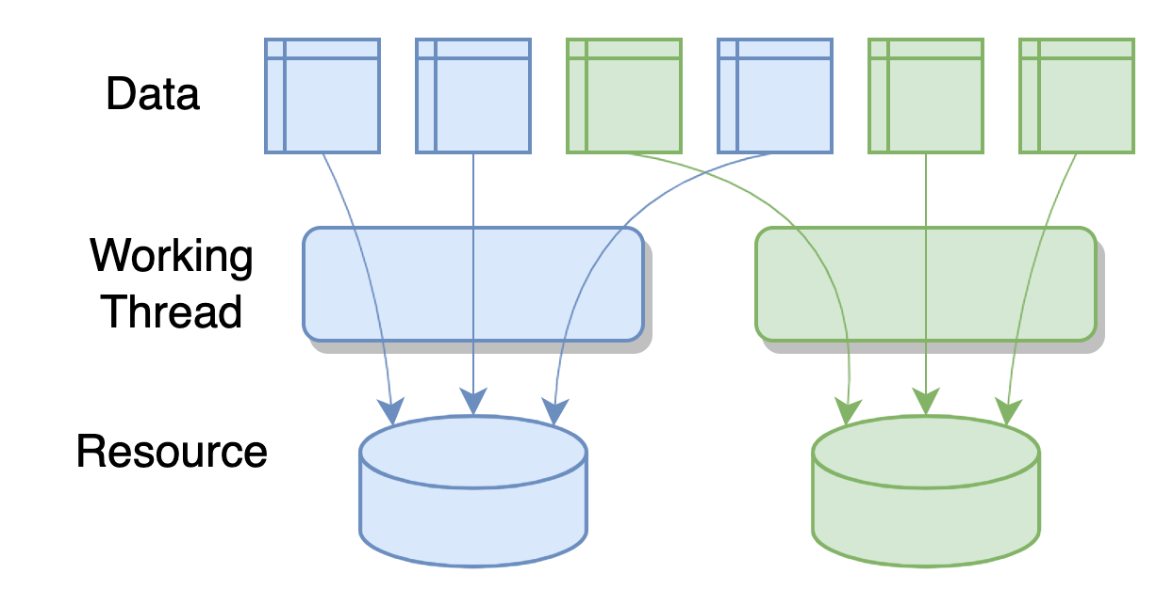
And what, must we give in return
Shard workload and resources
Notes:
Sharding is easy in some scenario
Able to reshard

Slide 20
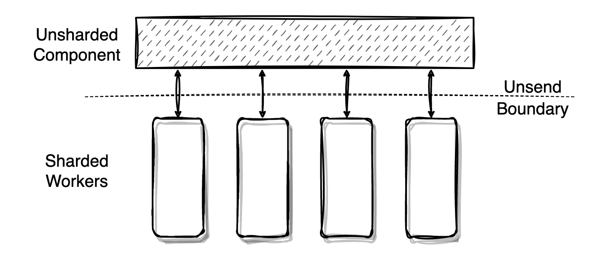
And what, must we give in return
Communicate with channel, build a Unsend Boundary.
Notes:
Represent function call as “task”

Slide 21
Existing tools can help
Runtime support
tokio
futures
glommio
monoio
pub fn spawn_local<F>(&self, future: F) -> JoinHandle<F::Output>
where
F: Future + 'static,
F::Output: 'static,
fn spawn_local<Fut>(&self, future: Fut) -> Result<(), SpawnError>
where
Fut: 'static + Future<Output = ()>,
pub fn spawn<T: 'static>(
&self,
future: impl Future<Output = T> + 'static
) -> Result<Task<T>, GlommioError<()>>
pub fn spawn<T>(future: T) -> JoinHandle<T::Output>ⓘ
where
T: Future + 'static,
T::Output: 'static,

Slide 22
Existing tools can help
Standard Library Utilities
Thread Local Storage
`Cell`s
std::thread::LocalKey
std::cell::RefCell

Slide 23
Existing tools can help
Clippy Lint: await_holding_refcell_ref`

Slide 24
We can make more with Rust
What we do not have in present.
Send is required in many places
Utilities considering exclusion ownership

Slide 25
We can make more with Rust
https://rustmagazine.github.io/rust_magazine_2021/chapter_11/play-async.html

Slide 26
03
About us

Slide 27
Join us!
Our community
github.com/CeresDB/ceresdb
Slack
WeChat
Work together: weirong.cwr@antgroup.com

